Slide 1
File Systems
Files
Directories
File system implementation
Example file systems

Slide 2
Long-term Information Storage
Must store large amounts of data
Information stored must survive the termination of the process using it
Multiple processes must be able to access the information concurrently

Slide 3
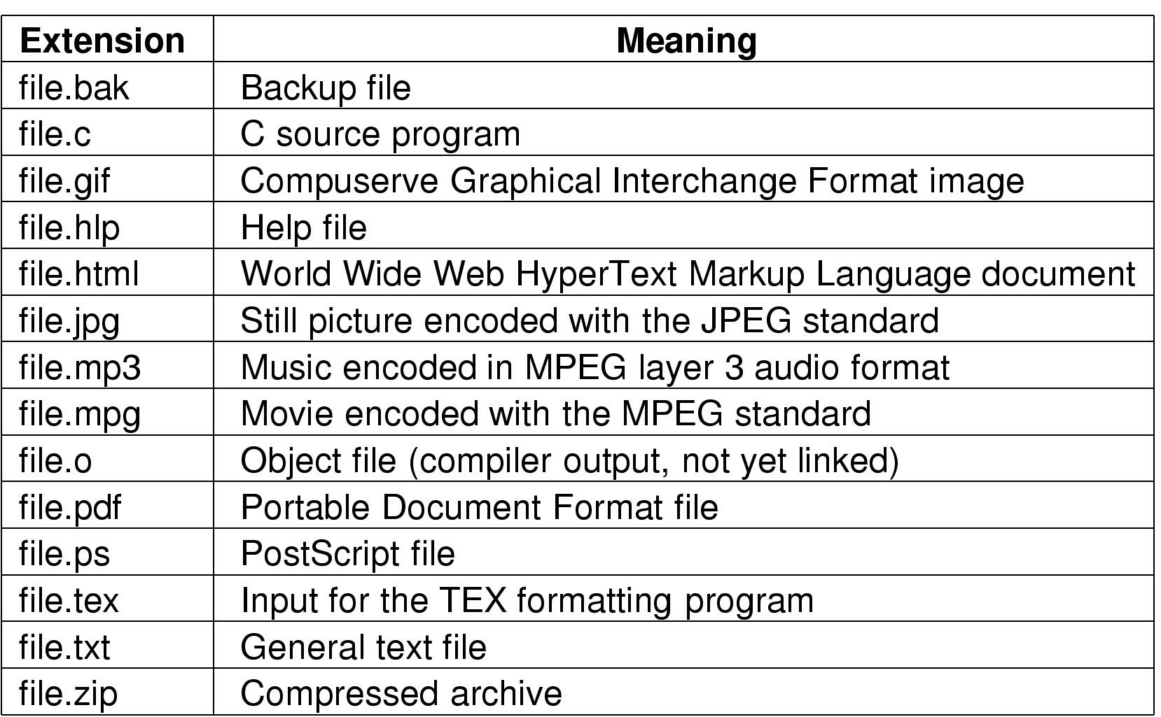
File Naming
Typical file extensions.

Slide 4
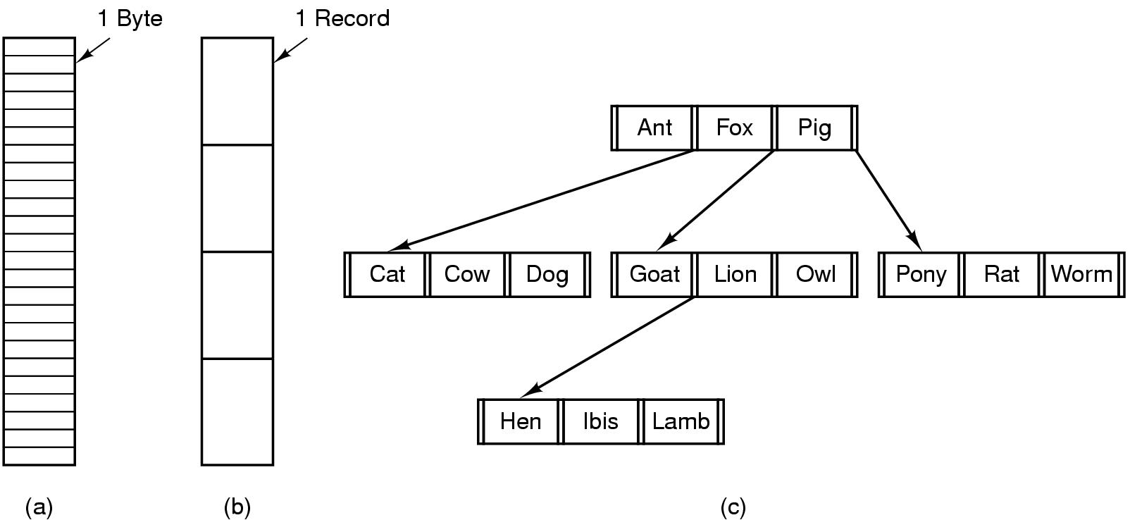
File Structure
Three kinds of files
byte sequence
record sequence
tree

Slide 5
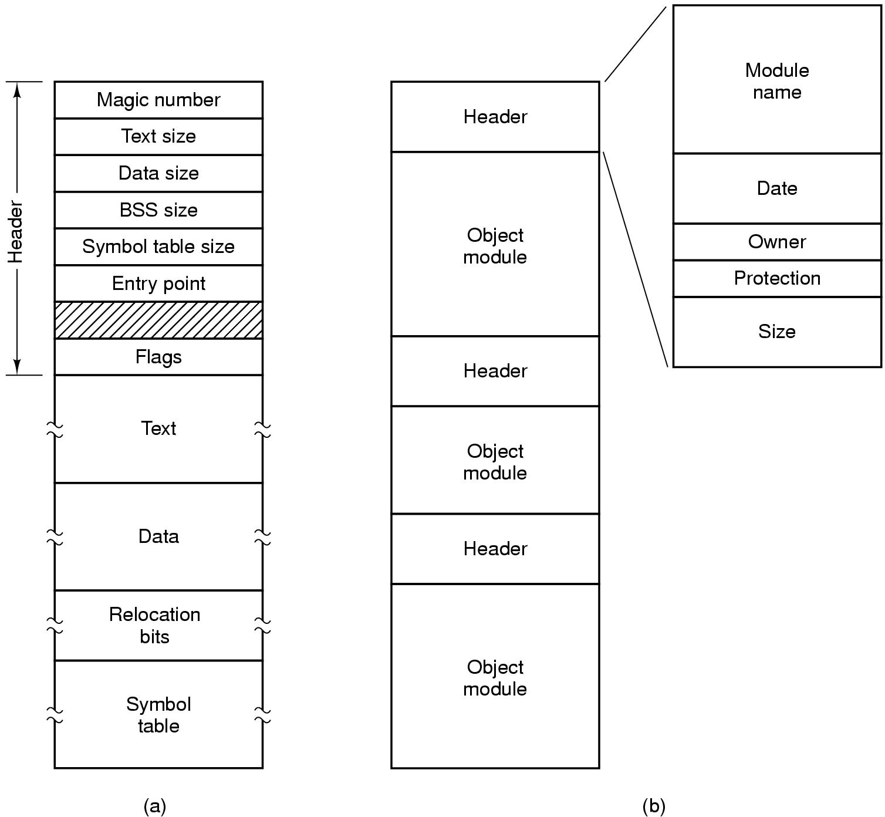
File Types
(a) An executable file (b) An archive

Slide 6
File Access
Sequential access
read all bytes/records from the beginning
cannot jump around, could rewind or back up
convenient when medium was mag tape
Random access
bytes/records read in any order
essential for data base systems
read can be …
move file marker (seek), then read or …
read and then move file marker

Slide 7
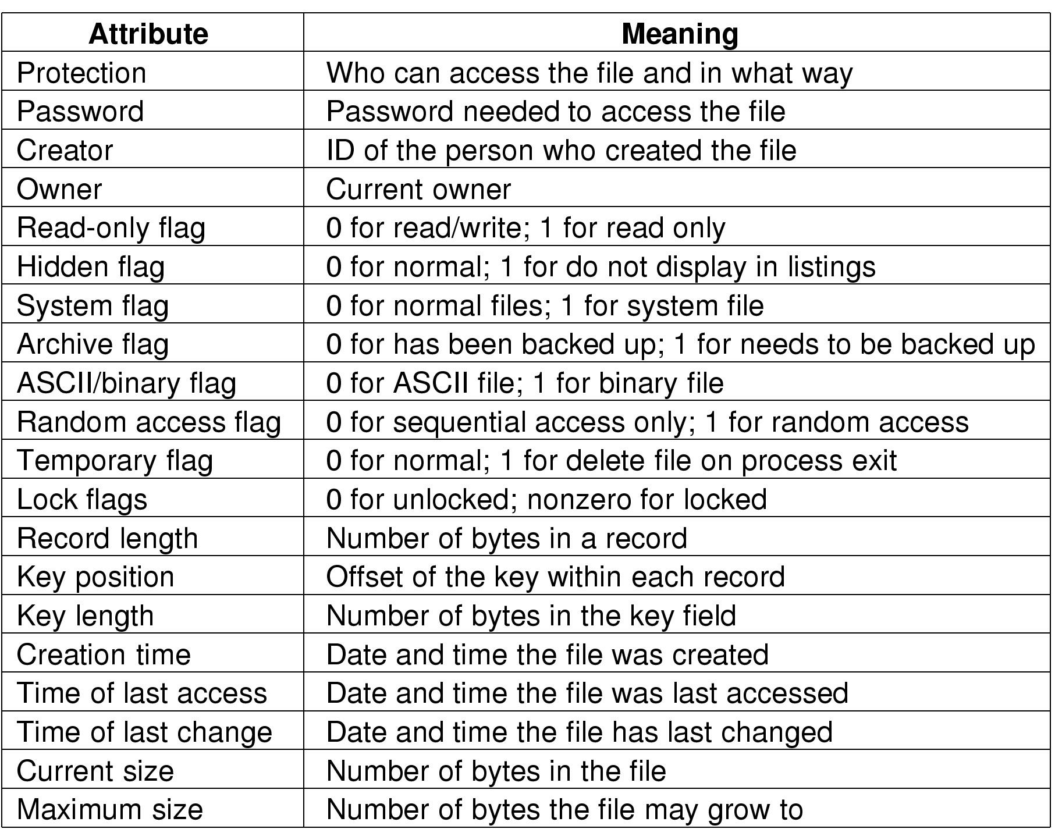
File Attributes
Possible file attributes

Slide 8
File Operations
Create
Delete
Open
Close
Read
Write
Append
Seek
Get attributes
Set Attributes
Rename

Slide 9
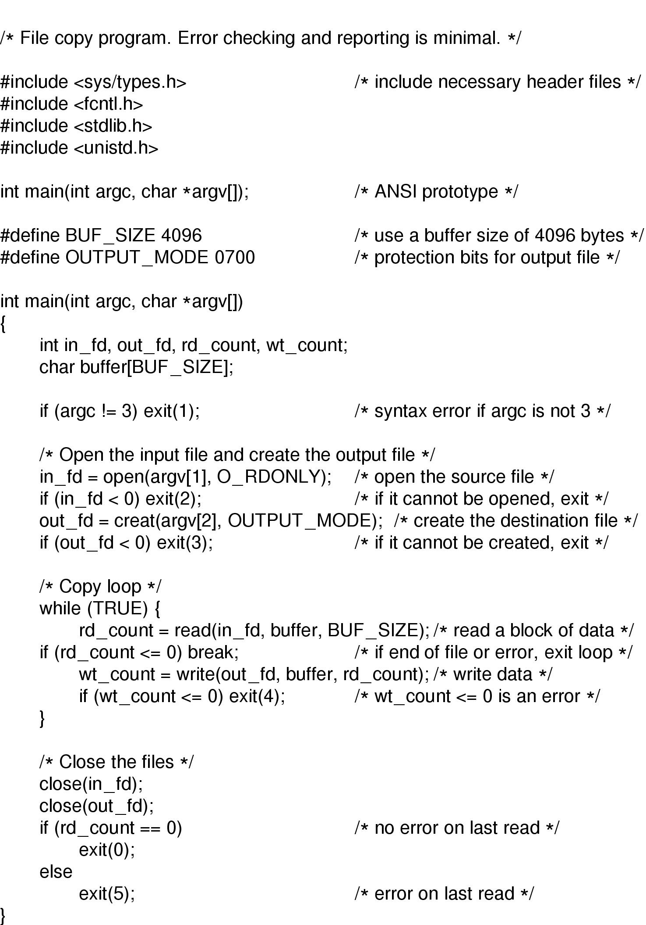
An Example Program Using File System Calls (1/2)

Slide 10
An Example Program Using File System Calls (2/2)

Slide 11
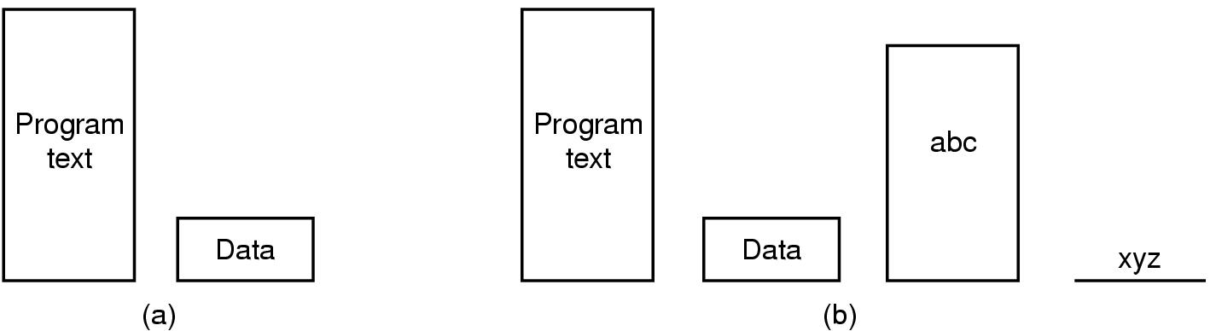
Memory-Mapped Files
(a) Segmented process before mapping files into its address space
(b) Process after mapping
existing file abc into one segment
creating new segment for xyz

Slide 12
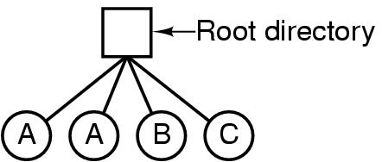
Directories Single-Level Directory Systems
A single level directory system
contains 4 files
owned by 3 different people, A, B, and C

Slide 13
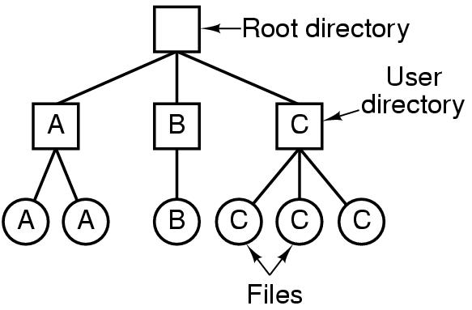
Two-level Directory Systems
Letters indicate owners of the directories and files

Slide 14
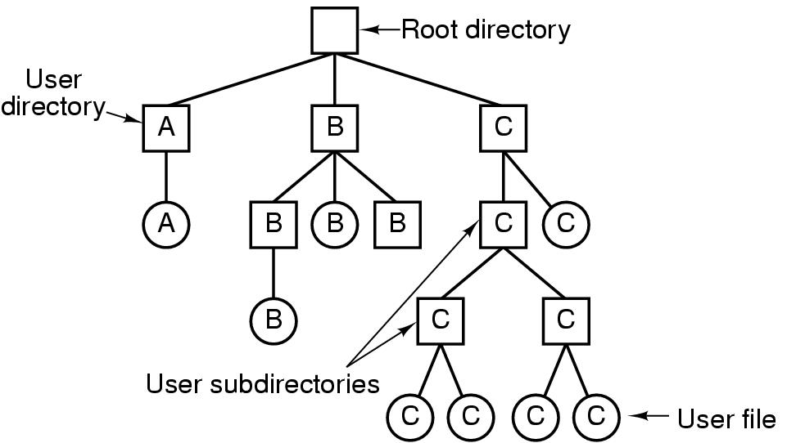
Hierarchical Directory Systems
A hierarchical directory system

Slide 15
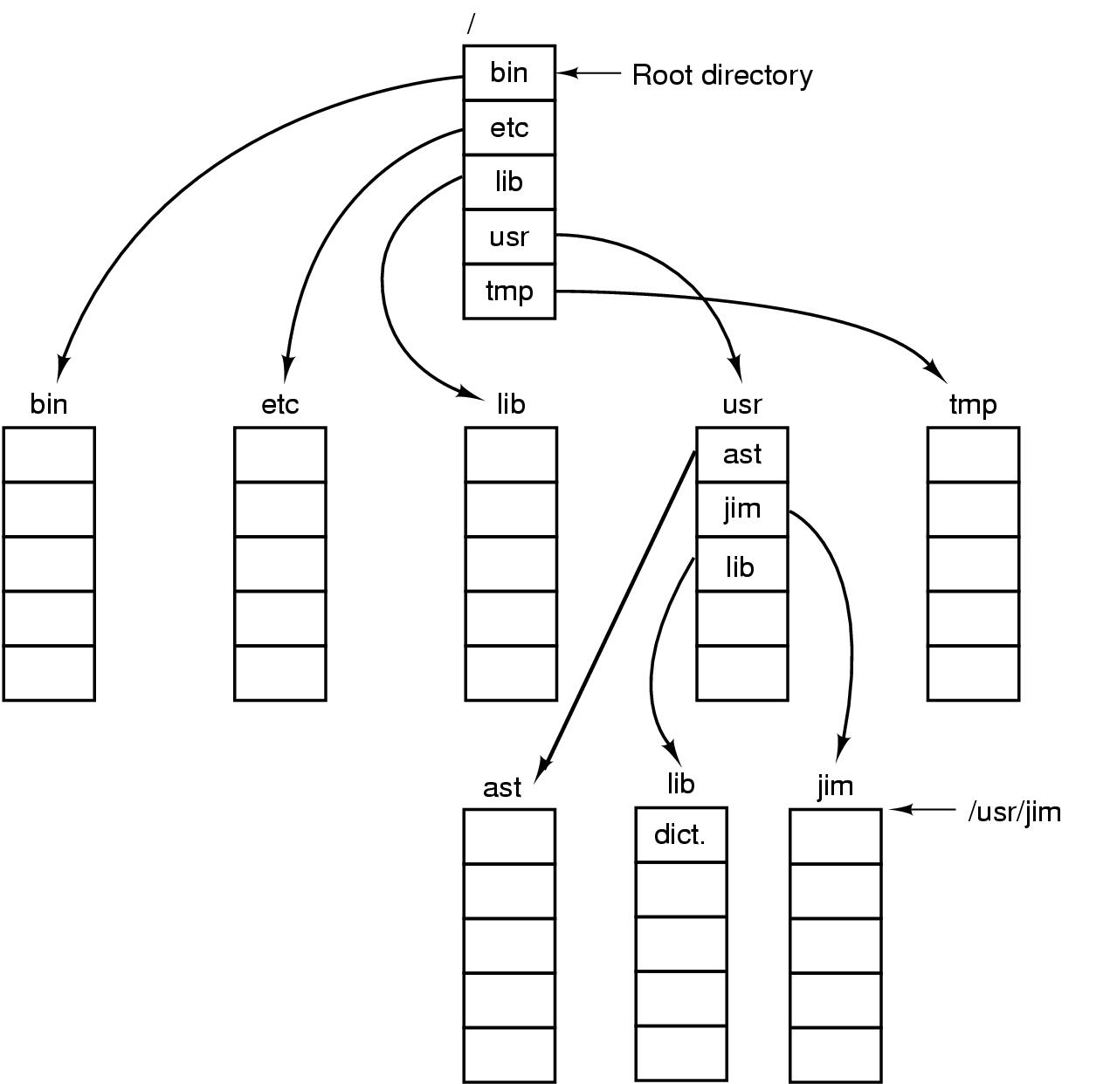
Path Names
A UNIX directory tree

Slide 16
Directory Operations
Create
Delete
Opendir
Closedir
Readdir
Rename
Link
Unlink

Slide 17
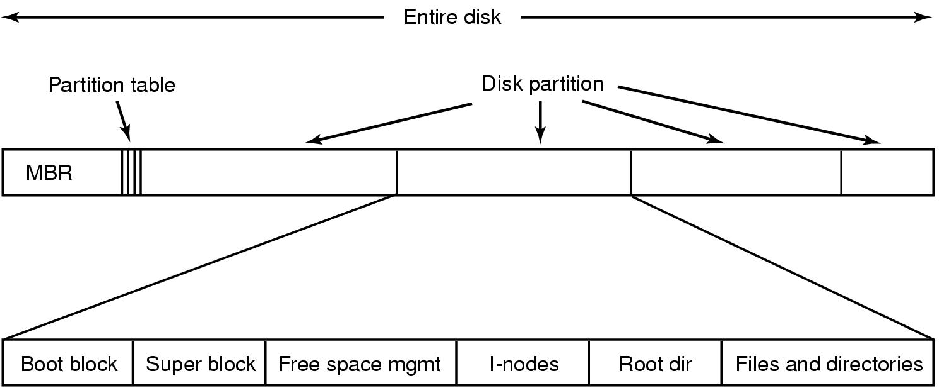
File System Implementation
A possible file system layout

Slide 18
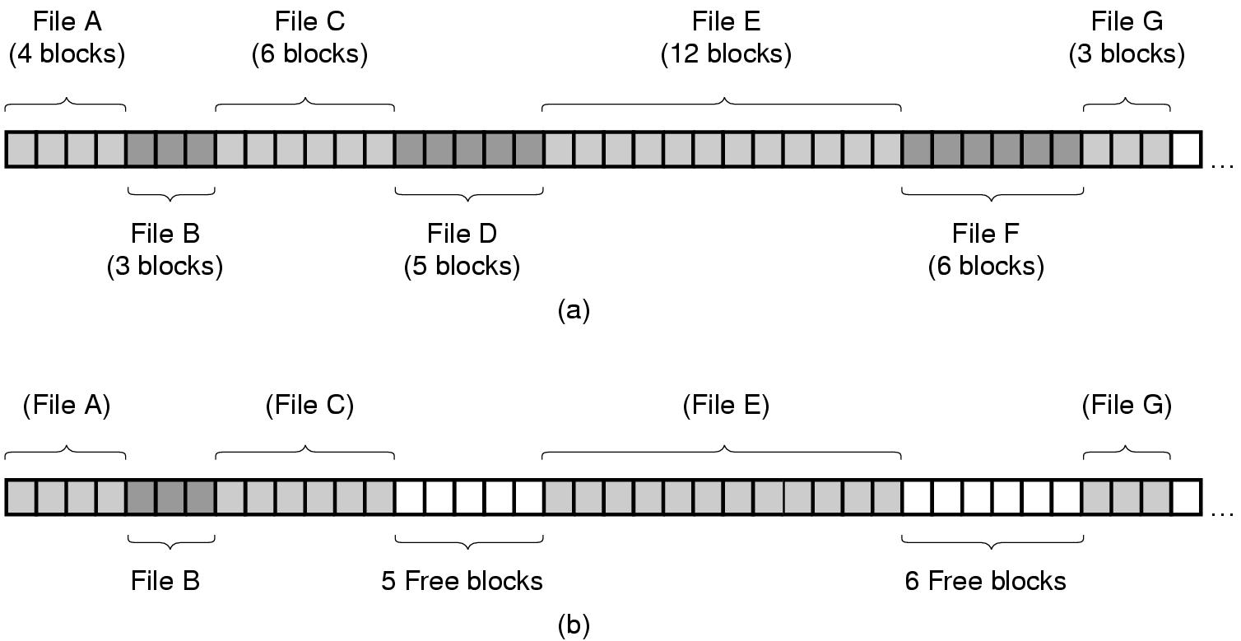
Implementing Files (1)
(a) Contiguous allocation of disk space for 7 files
(b) State of the disk after files D and E have been removed

Slide 19
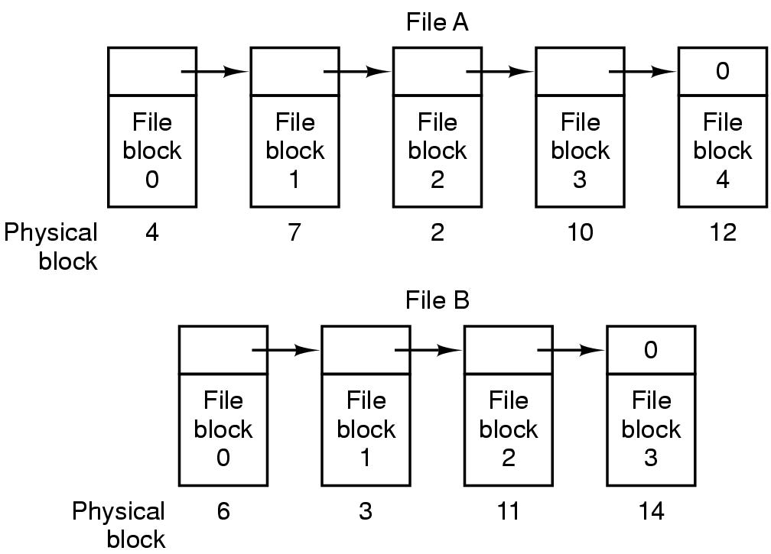
Implementing Files (2)
Storing a file as a linked list of disk blocks

Slide 20
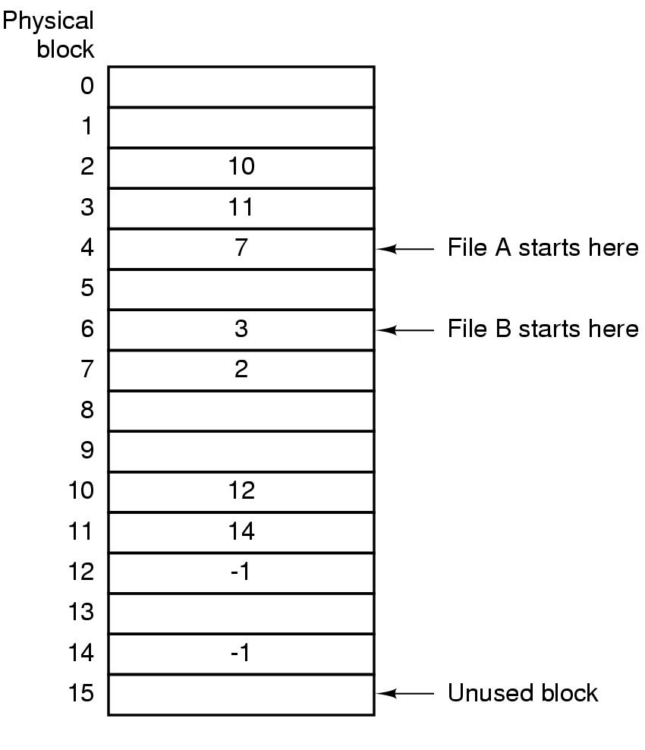
Implementing Files (3)
Linked list allocation using a file allocation table in RAM

Slide 21
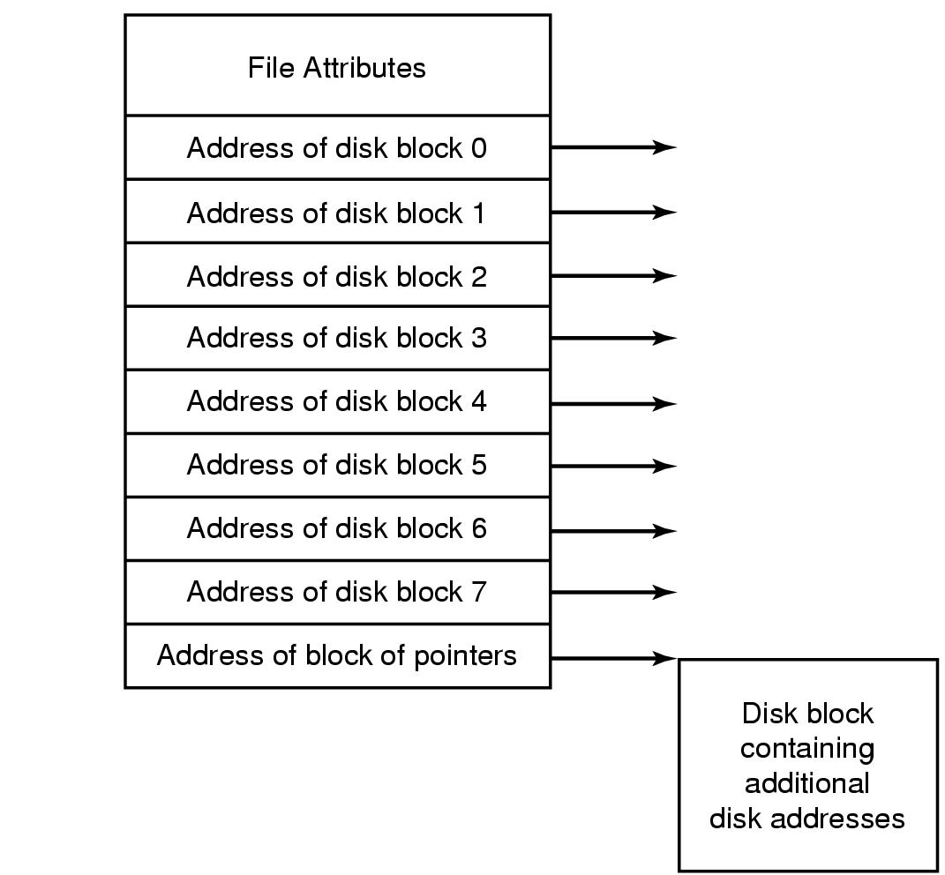
Implementing Files (4)
An example i-node

Slide 22
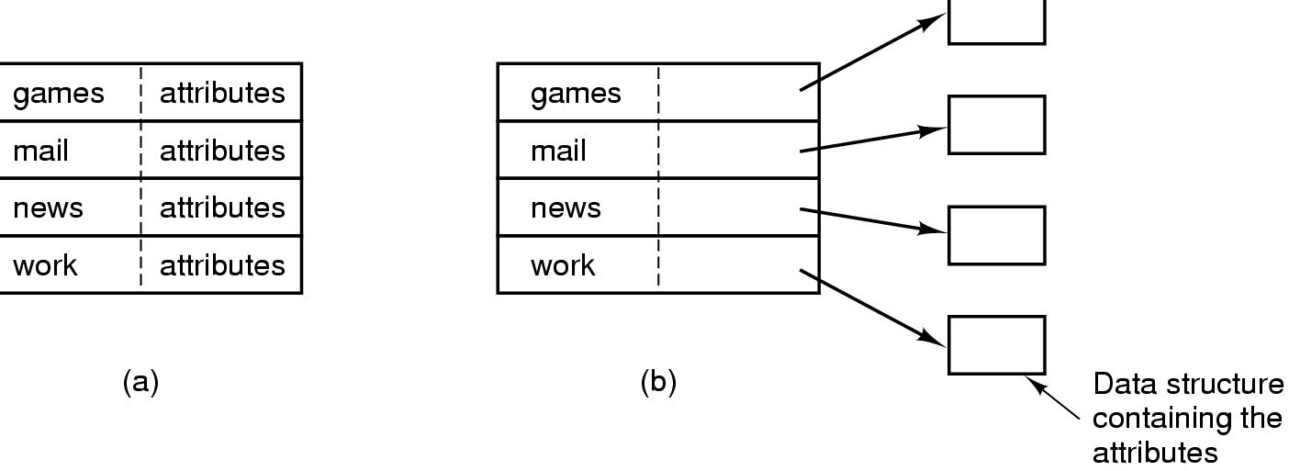
Implementing Directories (1)
(a) A simple directory
fixed size entries
disk addresses and attributes in directory entry
(b) Directory in which each entry just refers to an i-node

Slide 23
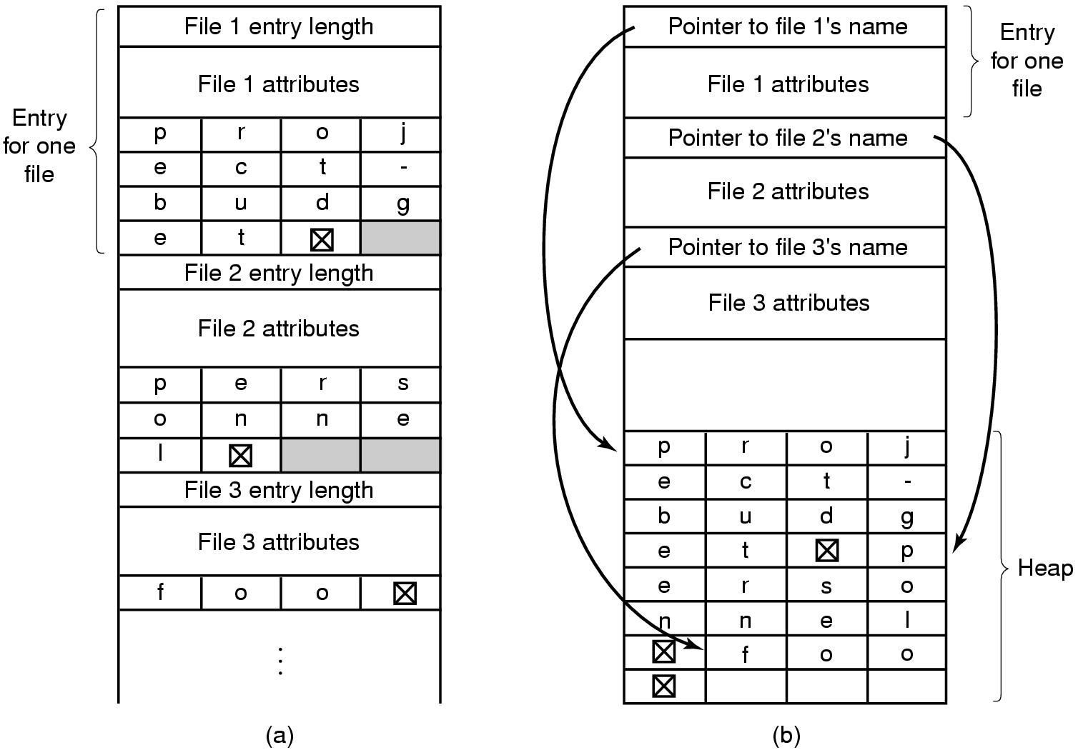
Implementing Directories (2)
Two ways of handling long file names in directory
(a) In-line
(b) In a heap

Slide 24
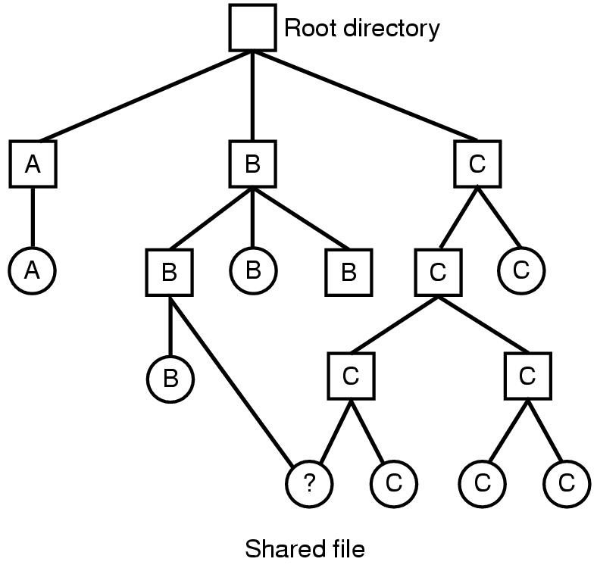
Shared Files (1)
File system containing a shared file

Slide 25
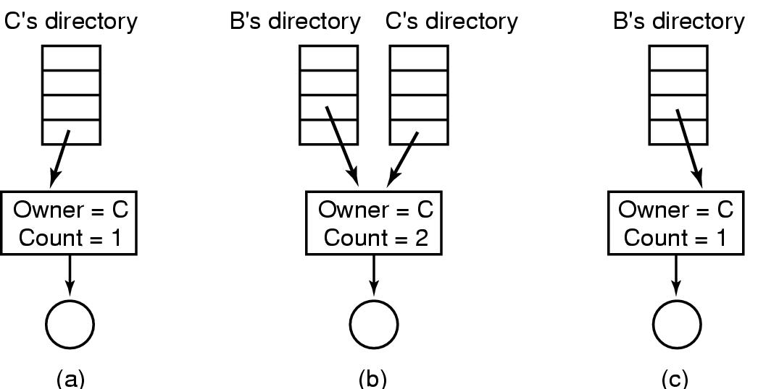
Shared Files (2)
(a) Situation prior to linking
(b) After the link is created
(c)After the original owner removes the file

Slide 26
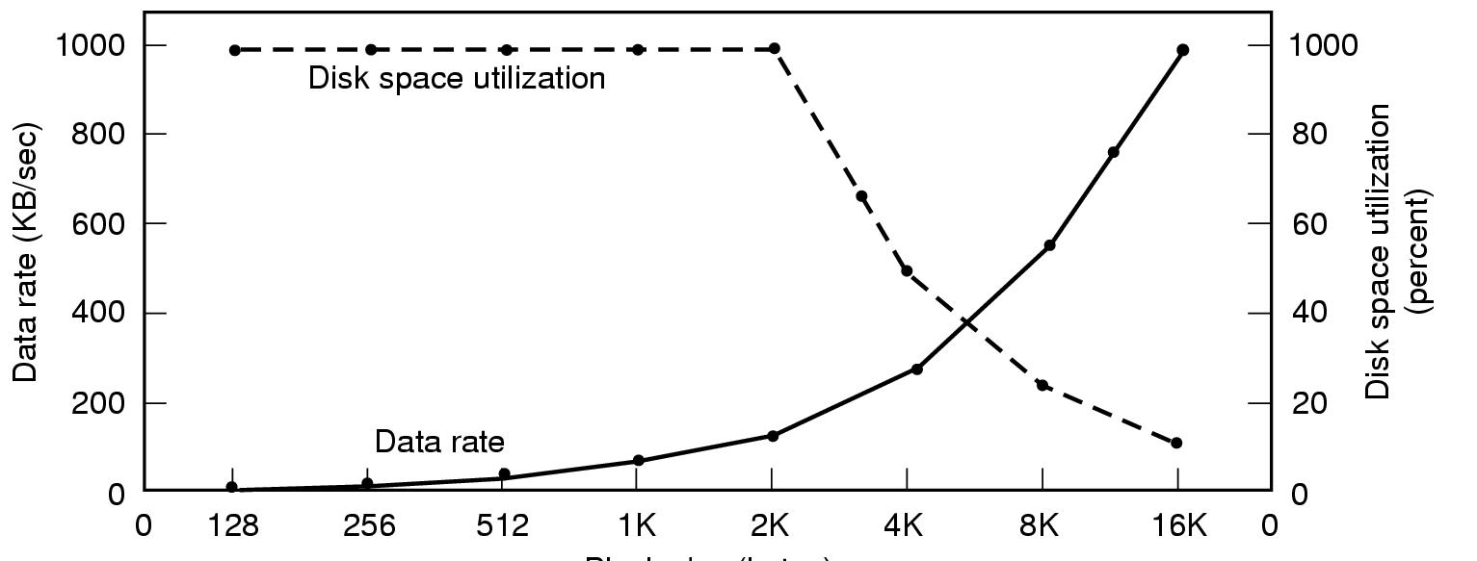
Disk Space Management (1)
Block size
Dark line (left hand scale) gives data rate of a disk
Dotted line (right hand scale) gives disk space efficiency
All files 2KB

Slide 27
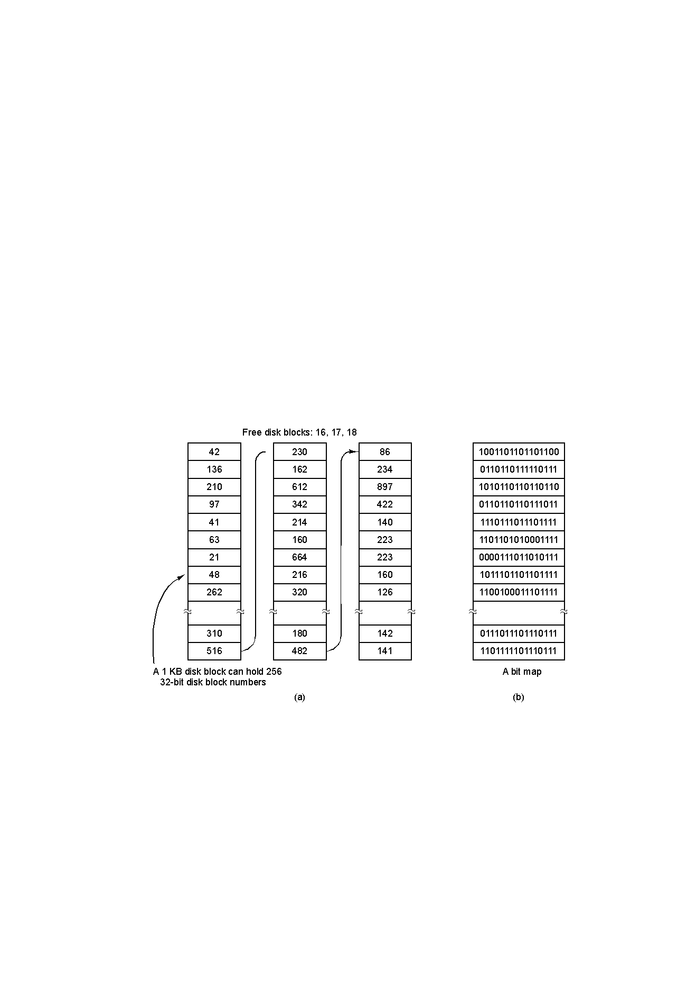
Disk Space Management (2)
(a) Storing the free list on a linked list
(b) A bit map

Slide 28
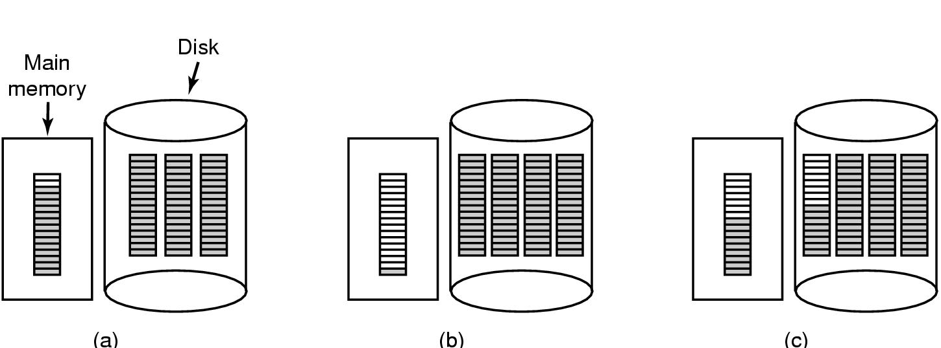
Disk Space Management (3)
(a) Almost-full block of pointers to free disk blocks in RAM
- three blocks of pointers on disk
(b) Result of freeing a 3-block file
(c) Alternative strategy for handling 3 free blocks
- shaded entries are pointers to free disk blocks

Slide 29
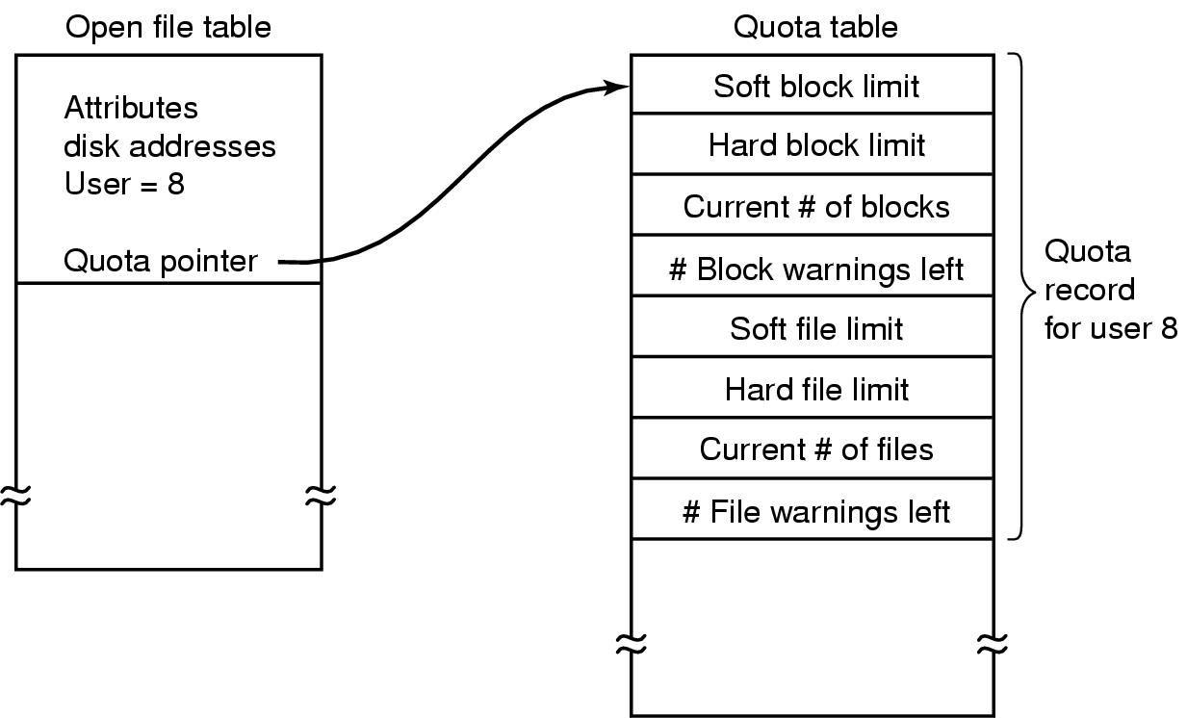
Disk Space Management (4)
Quotas for keeping track of each user’s disk use

Slide 30
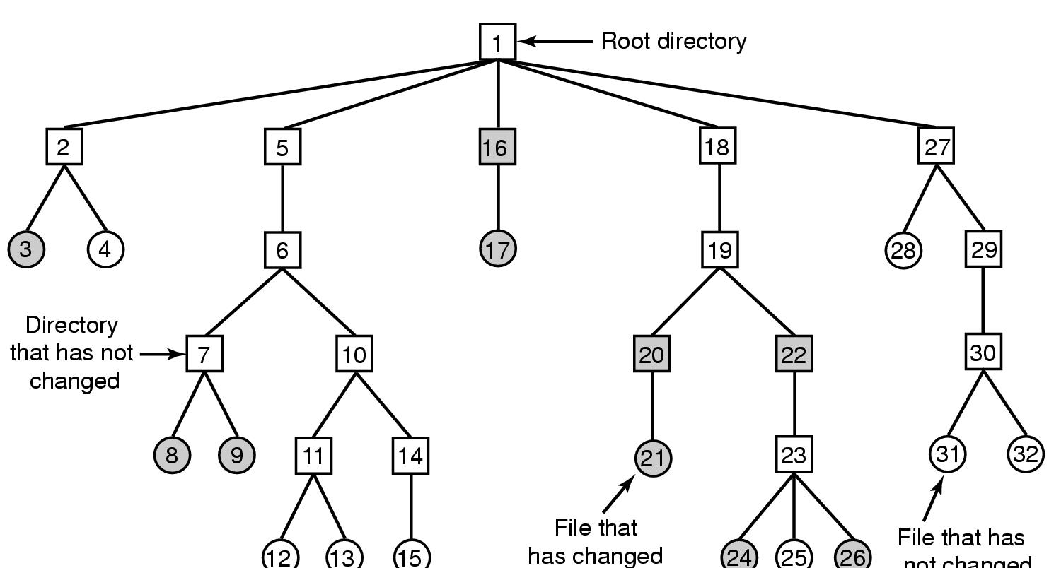
File System Reliability (1)
File that has
not changed
A file system to be dumped
squares are directories, circles are files
shaded items, modified since last dump
each directory & file labeled by i-node number

Slide 31
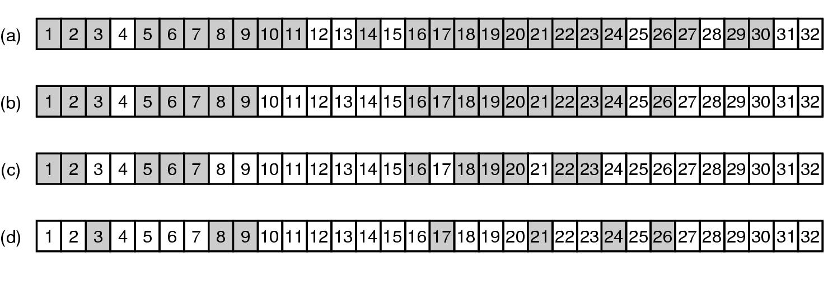
File System Reliability (2)
Bit maps used by the logical dumping algorithm

Slide 32
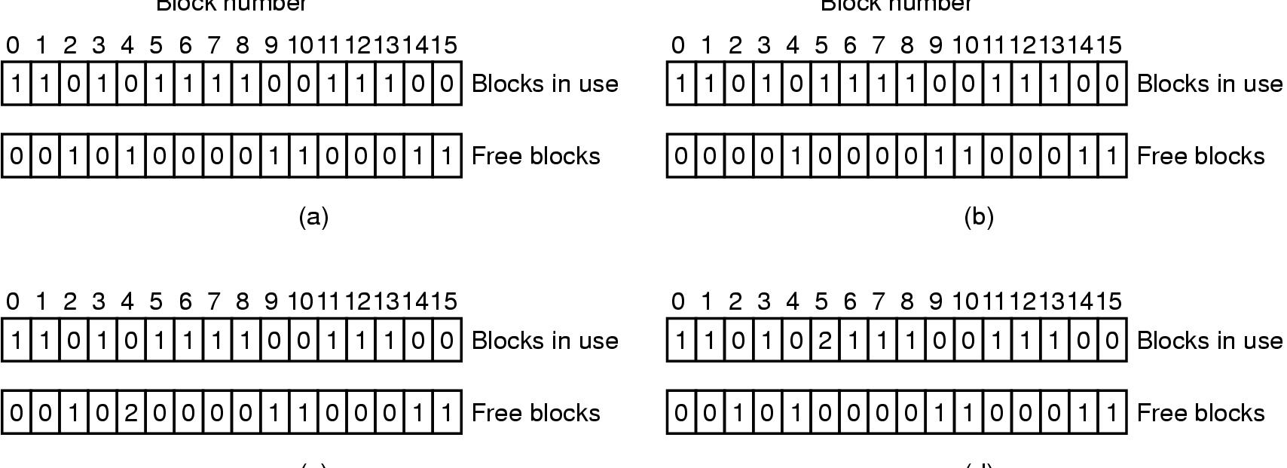
File System Reliability (3)
File system states
(a) consistent
(b) missing block
(c) duplicate block in free list
(d) duplicate data block

Slide 33
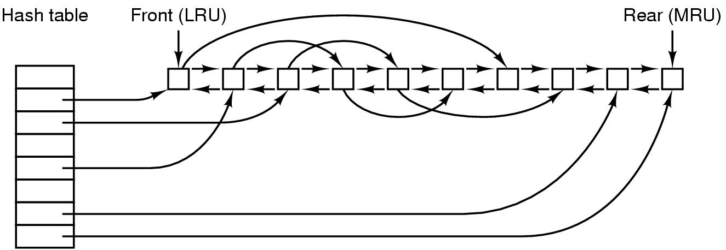
File System Performance (1)
The block cache data structures

Slide 34
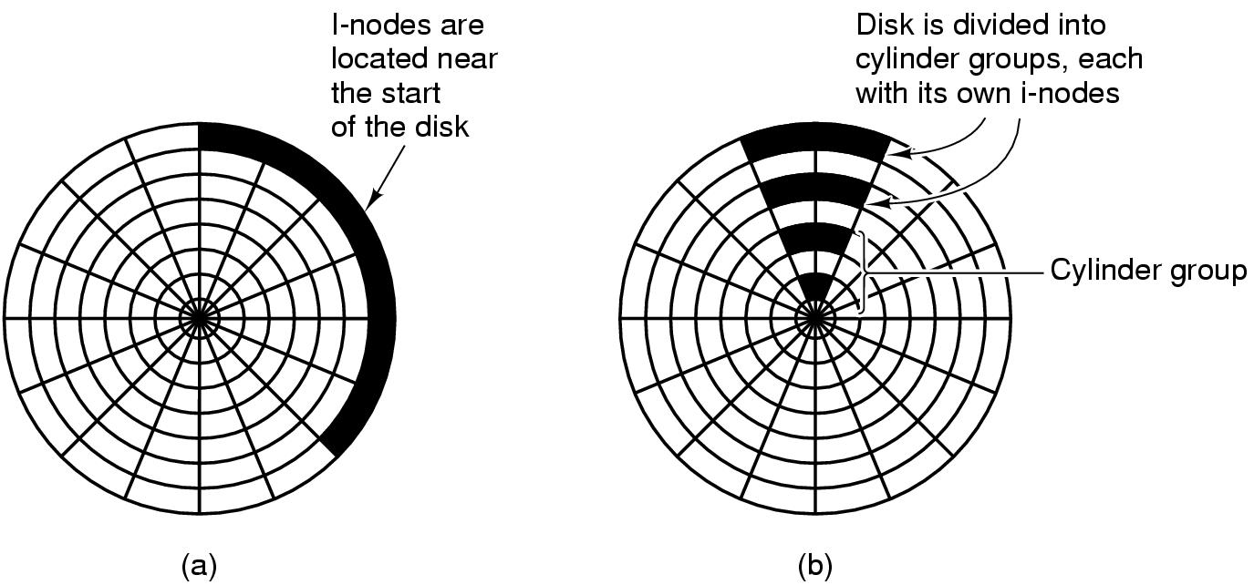
File System Performance (2)
I-nodes placed at the start of the disk
Disk divided into cylinder groups
each with its own blocks and i-nodes

Slide 35
Log-Structured File Systems
With CPUs faster, memory larger
disk caches can also be larger
increasing number of read requests can come from cache
thus, most disk accesses will be writes
LFS Strategy structures entire disk as a log
have all writes initially buffered in memory
periodically write these to the end of the disk log
when file opened, locate i-node, then find blocks

Slide 36
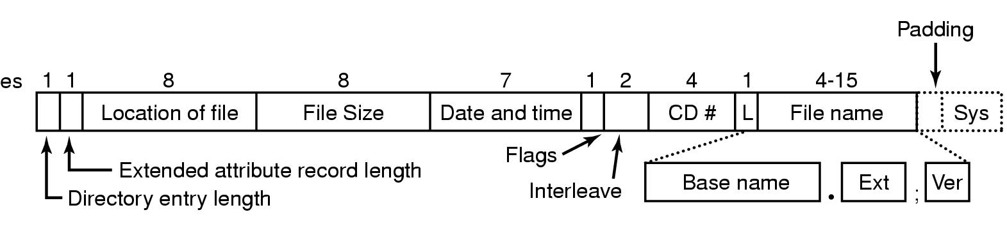
Example File Systems CD-ROM File Systems
The ISO 9660 directory entry

Slide 37
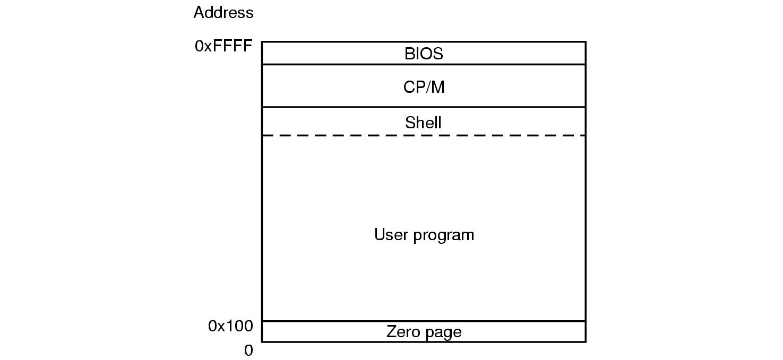
The CP/M File System (1)
Memory layout of CP/M

Slide 38
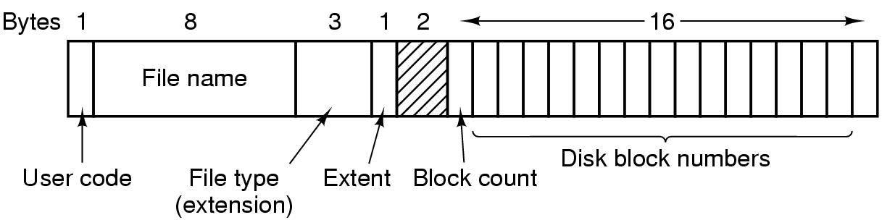
The CP/M File System (2)
The CP/M directory entry format

Slide 39
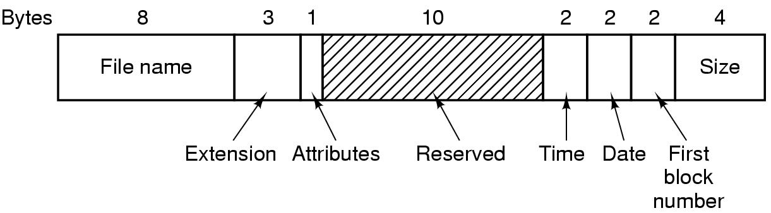
The MS-DOS File System (1)
The MS-DOS directory entry

Slide 40
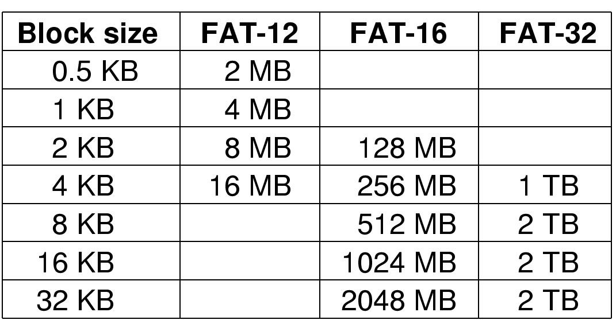
The MS-DOS File System (2)
Maximum partition for different block sizes
The empty boxes represent forbidden combinations

Slide 41
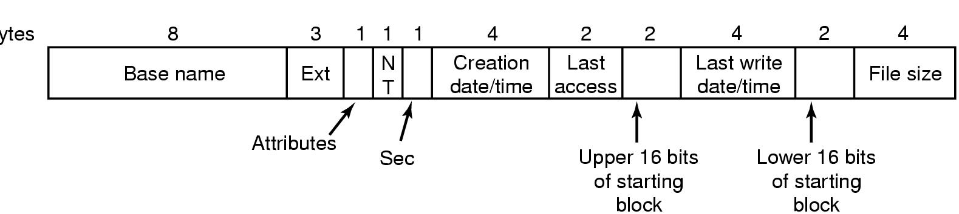
The Windows 98 File System (1)
Bytes
The extended MOS-DOS directory entry used in Windows 98

Slide 42
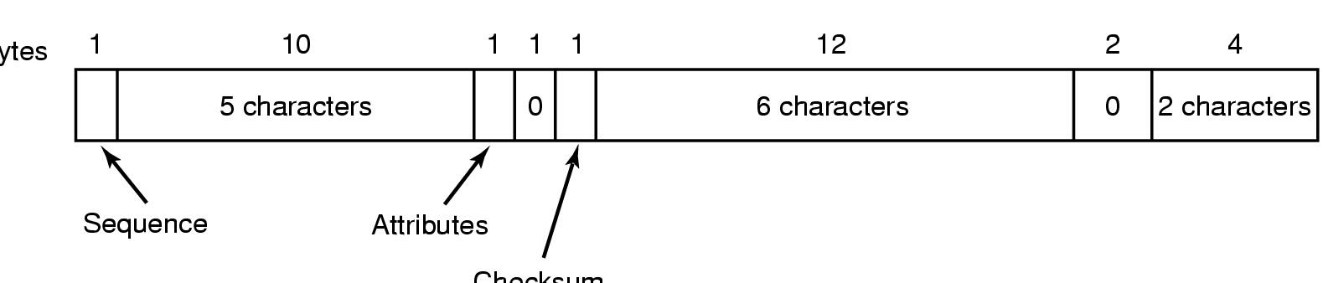
The Windows 98 File System (2)
Bytes
Checksum
An entry for (part of) a long file name in Windows 98

Slide 43
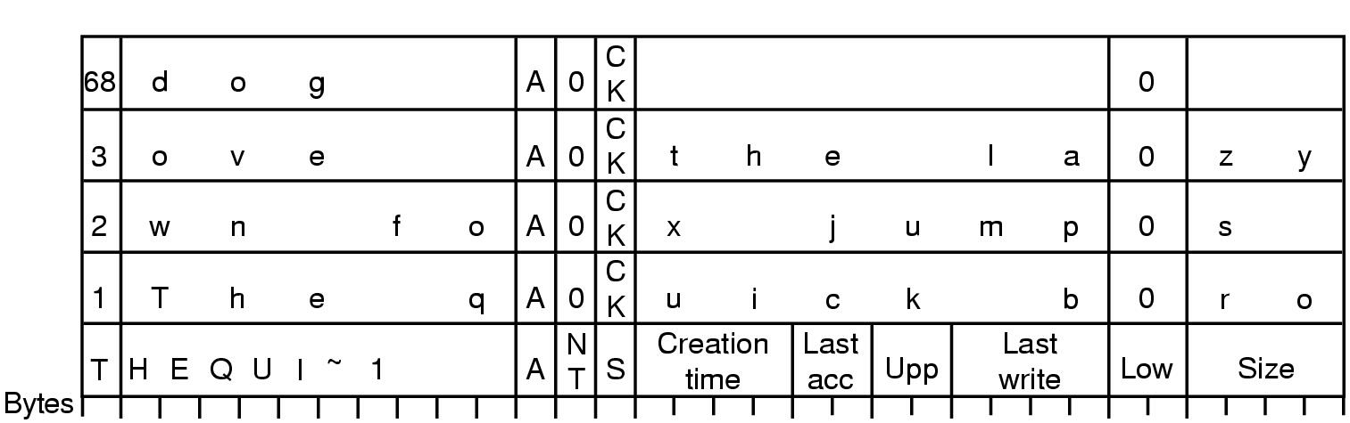
The Windows 98 File System (3)
An example of how a long name is stored in Windows 98

Slide 44
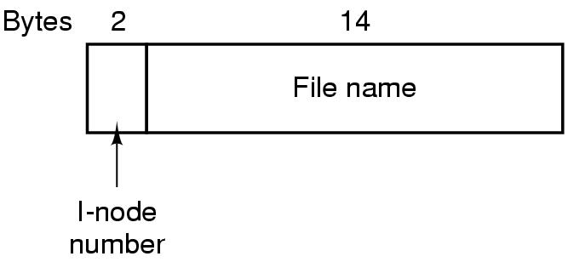
The UNIX V7 File System (1)
A UNIX V7 directory entry

Slide 45
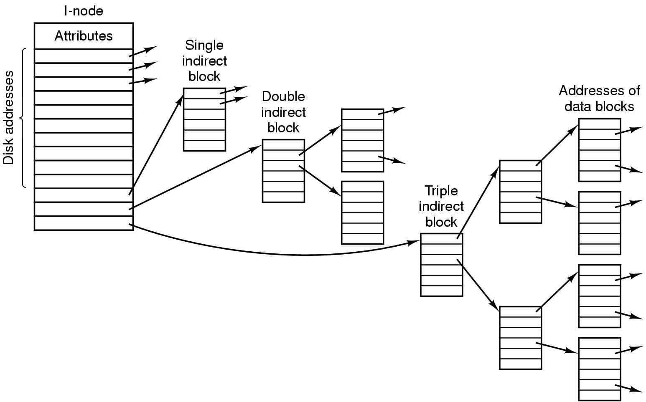
The UNIX V7 File System (2)
A UNIX i-node

Slide 46
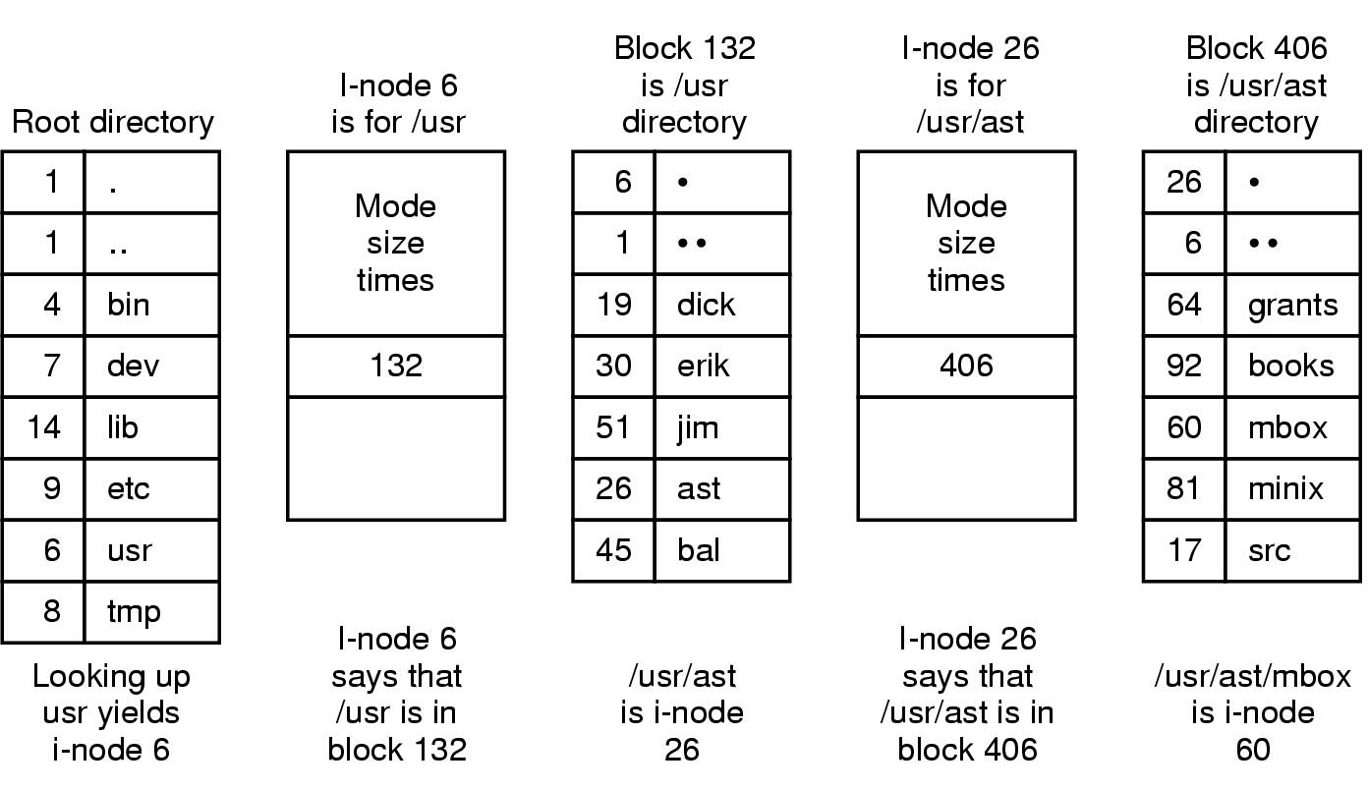
The UNIX V7 File System (3)
The steps in looking up /usr/ast/mbox

